Slide 1
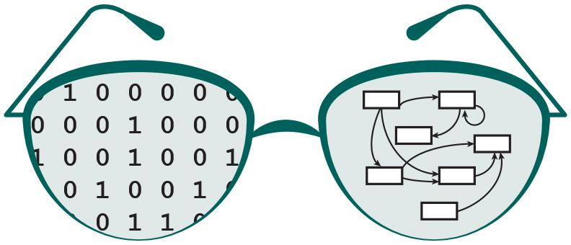

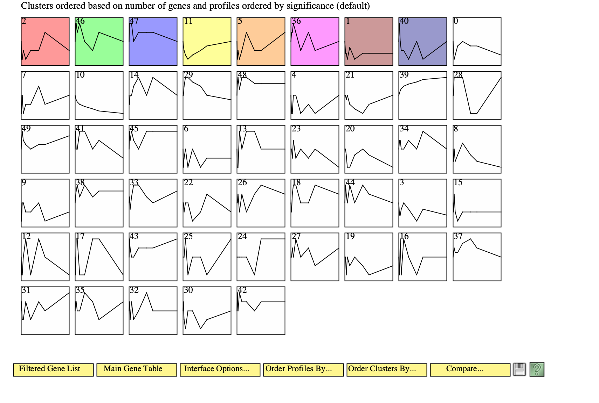
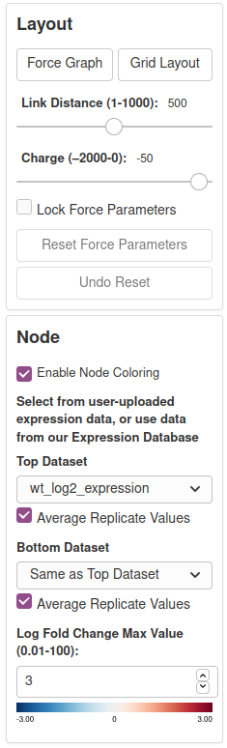
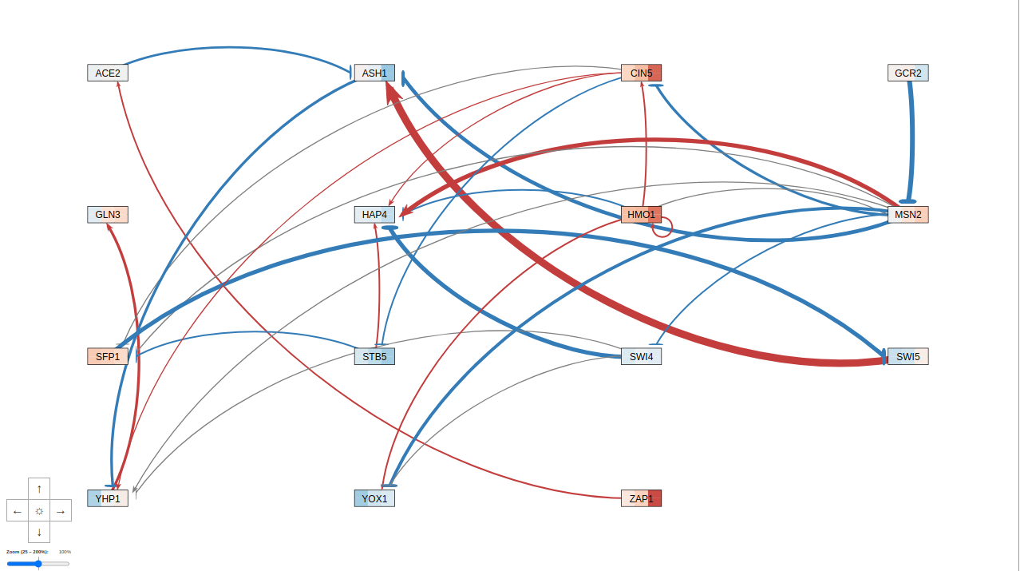
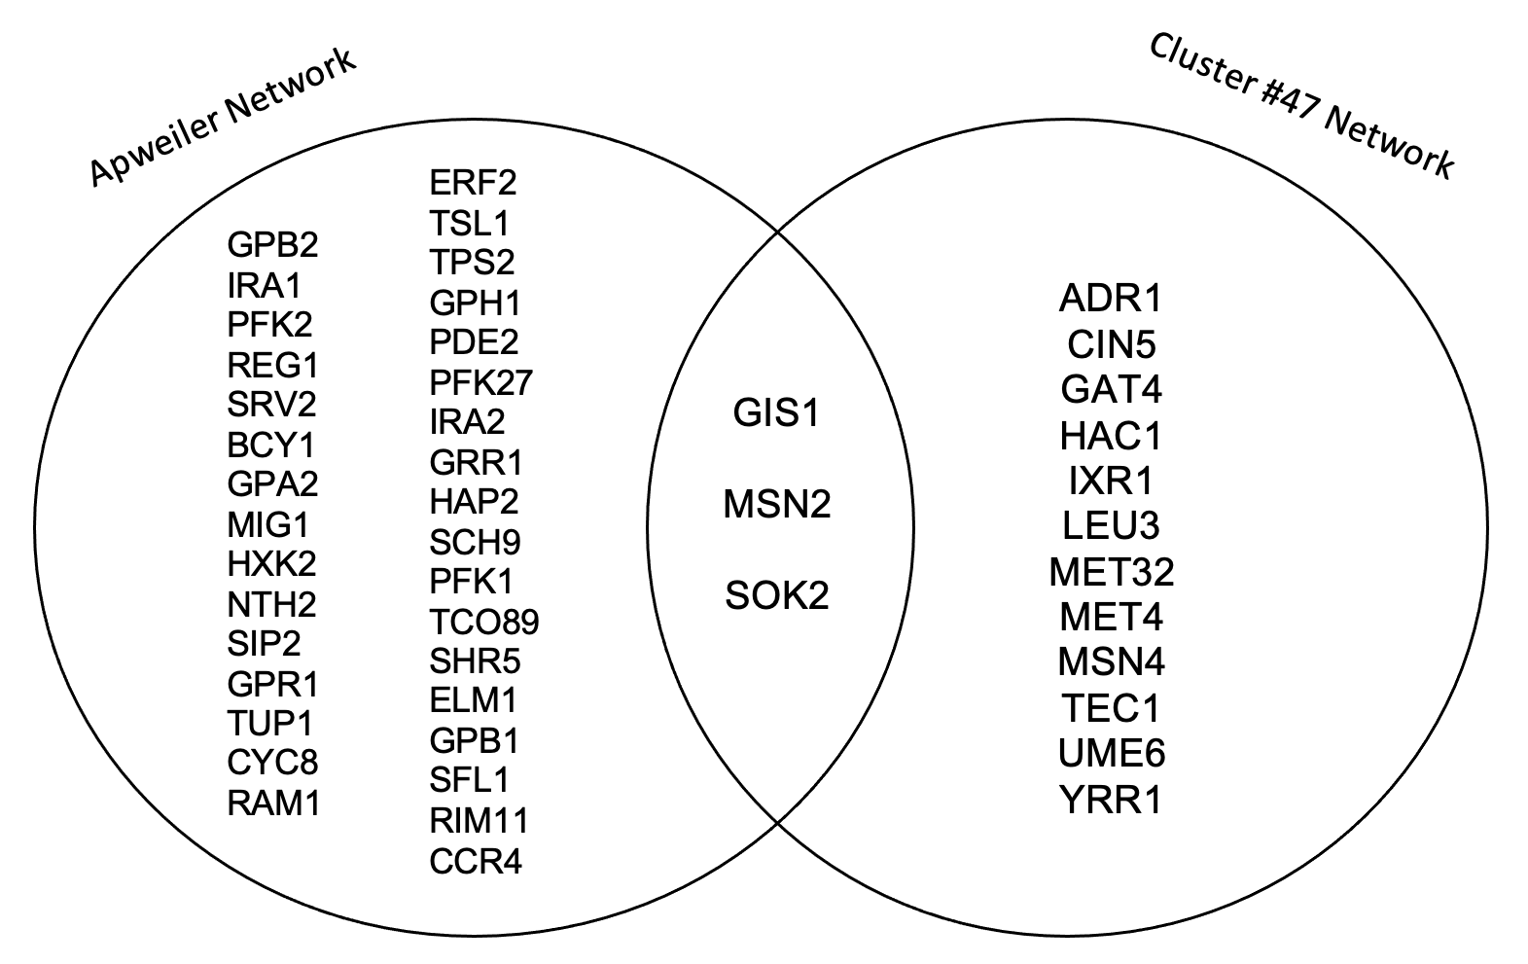
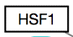
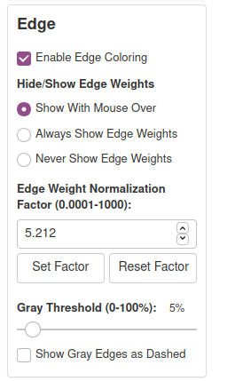
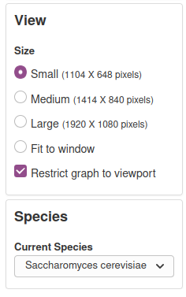
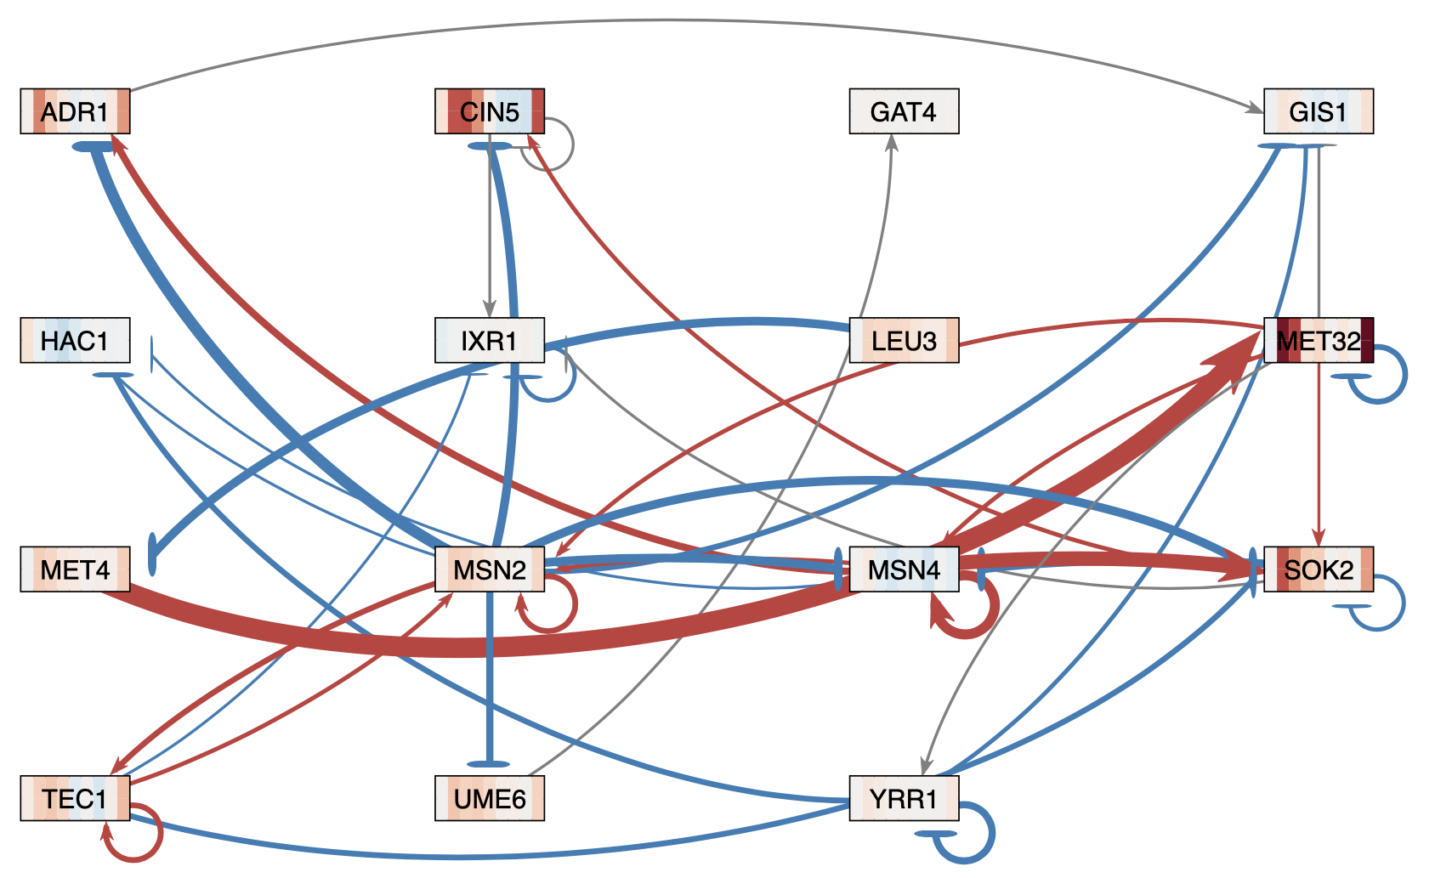
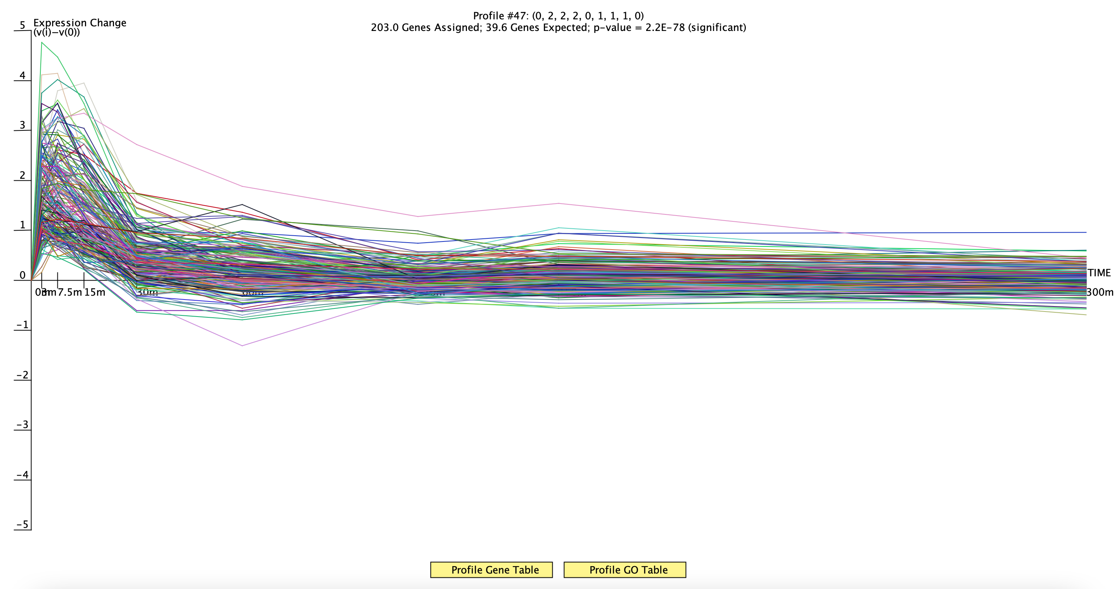
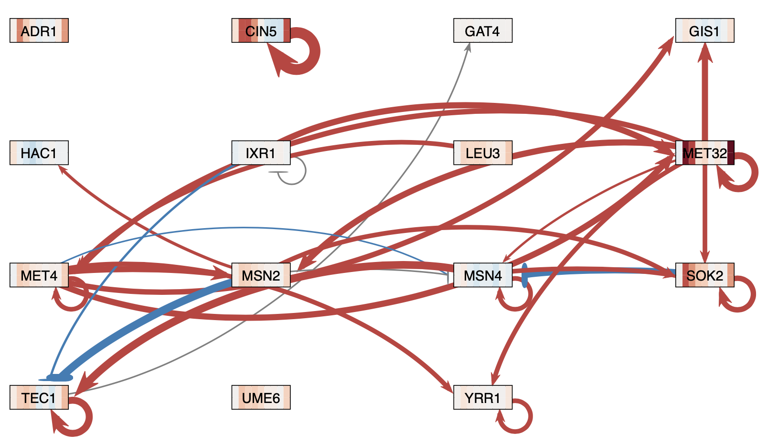
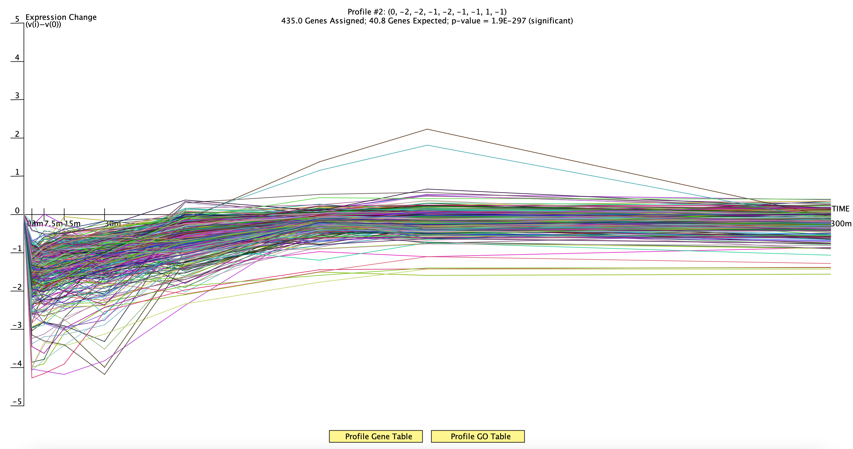
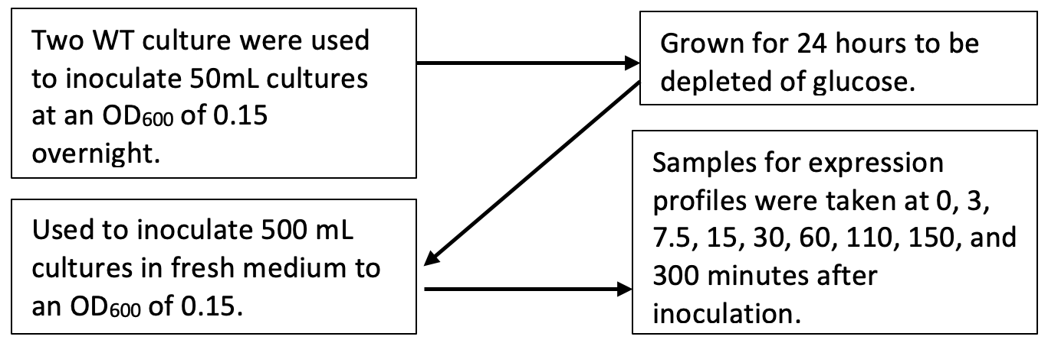
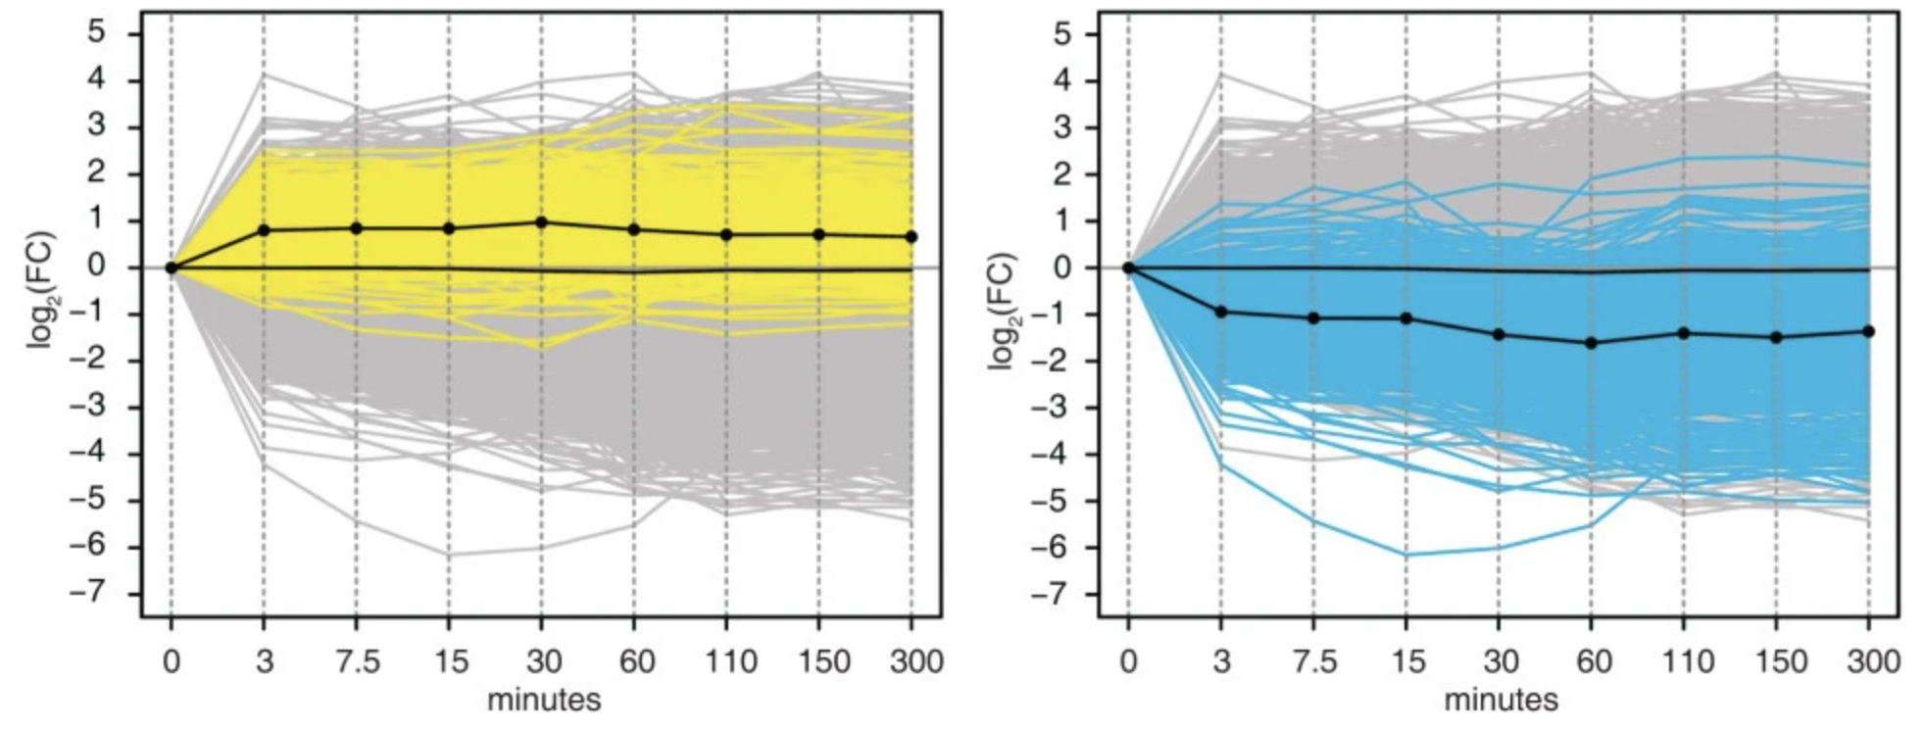


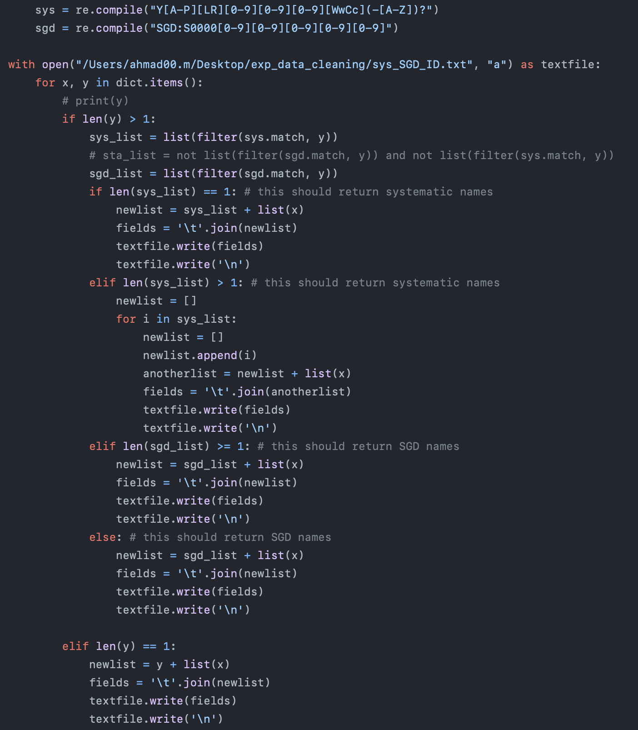
A New Gene Expression Dataset for GRNsight: a Web Application for Visualizing Gene Network Models
Ahmad R. Mersaghian*, Sarron A. Tadesse **, Kam D. Dahlquist*, John David N. Dionisio**
*Department of Biology, **Department of Computer Science, Loyola Marymount University, 1 LMU Drive, Los Angeles, CA 90045
http://dondi.github.io/GRNsight/
GRNsight Automatically Lays Out Unweighted and Weighted Gene Regulatory Network Graphs
STEM Clustering to Observe Gene Expression Patterns
.
Clustering analysis using STEM
Run the STEM clustering method to observe gene expression patterns.
It found 8 significant profiles with up- and down-regulation patterns.
The first four significant profiles were chosen to be analyzed further.
The profiles from STEM are consistent with the conclusions from the Apweiler et al. (2012) paper.
Find the candidate transcription factors responsible for the expression patterns observed in the four clusters.
Generate a gene regulatory network for the first four significant clusters and the top 15 transcription factors using YEASTRACT.
Visualize the networks with GRNsight to check that the network is completely connected.
Generate another gene regulatory network with the same genes using the Saccharomyces Genome Database.
The Venn diagram shows there are 3 common transcription factors between our profile #47 network and the network reconstruction from the Apweiler et al. (2012) paper.
There were no common transcription factors for the most significant profile (#2).
1. File Formats
Can import and export Excel, SIF, or GraphML files.
Demo files are provided.
1
2. Grid Layout
Grid Layout button allows the users to toggle the graph between a grid layout and a force graph layout.
3. Force Graph Parameter Sliders
Link distance determines the minimum distance between nodes.
Nodes have a charge, which repel or attract other nodes.
Reset functionality sets all parameters to default.
Locking the parameters prevents any further changes.
5. GRNsight includes options to show or hide the weight values
Buttons enable the user to always see edge weights, never see edge weights, or see edge weights upon mouseover of the edges.
6. Edge Weight Normalization
Allows user to set normalization factor in user interface.
Edge thicknesses for different graphs can be rendered on the same scale.
7. Viewport
Graph bounding box can be separated from viewport.
Multiple viewport sizes available.
Zooming and scrolling enabled.
2
2
3
3
4. Node Coloring
This menu allows users to modify parameters of the node coloring visualization.
Dataset options are automatically generated from expression data sheets detected in an Excel input workbook.
A back-end PostgreSQL gene expression database can also be used to color nodes.
With the addition of data from the current poster there is a total of four datasets available.
4
Key
4
gene
activation
repression
weak influence
5
7
Apweiler et al. (2012) performed a hierarchical network reconstruction method for network analysis with a larger number of genes, working with both of their clusters, while our networks are smaller and based on a single cluster.
5
8. Species Selection
This dropdown allows the user to change the chosen species to any other species supported by GRNsight.
6
8
The figure on the right shows the expression profile of profile #47 for the 5-hour duration of the experiment. This figure clearly shows an initial up-regulation followed by down-regulation of gene expression.
Gene Regulatory Network of profile 47 from YEASTRACT Database with 38 edges. The weight of the edges were calculated using GRNmap.
Apweiler et al. (2012) Investigated the Effect of Glucose on Gene Expression in Budding Yeast
Apweiler et al. (2012) conducted a time-course experiment measuring the gene expression of Sccharomyces cerevisiae Wild Type (WT) cells that were glucose-depleted.
The figure shows that the transcripts behave in one of two ways, upregulation (yellow) or downregulation (blue).
The grey portion of the graph demonstrates the nonsignificant transcript expression, and the black line shows the average transcript expression.
The figure on the left shows the expression profile of profile #2 for the 5-hour duration of the experiment. This figure clearly shows an initial down-regulation followed by up-regulation of gene expression.
Gene Regulatory Network of profile 47 from
Saccharomyces Genome Database with 30 edges. The weight of the edges were calculated using GRNmap.
This figure shows the line graph of transcriptional output of glucose-depleted Wild Type cells inoculated into fresh media (Synthetic Complete medium, supplemented with 2% glucose) over a period of 5 hours (Apweiler et al., 2012).
Availability
Future Directions
GRNsight is free and open to all users and there is no login requirement.
Web site content is available under the Creative Commons Attribution Non-Commercial Share Alike license.
GRNsight code is available under the open-source BSD license.
Usage is being tracked through Google Analytics.
Current version on Master: V5.1.0
New Users: 7,346
Load Apweiler et al. (2012) dataset into PostgreSQL.
Run GRNmap with alternative parameters to obtain more accurate weight estimation of the direction strength and weight of the activation/repression of genes.
Work on outstanding bugs and feature enhancements to the graph display and user interface.
Preparation of Apweiler et al. (2012) Dataset for Addition to GRNsight Database
File Uploads: 7,811
For each timepoint, take the average of the duplicate log₂ fold change measures for each gene.
Convert all the gene IDs into Systematic IDs using the YeastMine database.
Remove repeated expression data because of alias gene IDs with a custom Python script.
Sessions: 18,091
Pageviews: 38,472
References
Acknowledgments
Dahlquist, K.D., Dionisio, J.D.N., Fitzpatrick, B.G., Anguiano N.A., Varshneya A., Southwick, B.J., Samdarshi, M. (2016) GRNsight: a web application and service for visualizing models of small- to medium-scale gene regulatory networks. PeerJ Computer Science 2:e85 https://doi.org/10.7717/peerj-cs.85
Dahlquist, K.D., Fitzpatrick, B.G., Camacho, E.T., Entzminger, S.D., and Wanner, N.C. (2015) Parameter Estimation for Gene Regulatory Networks from Microarray Data: Cold Shock Response in Saccharomyces cerevisiae. Bulletin of Mathematical Biology, 77(8), 1457-1492 https://doi.org/0.1007/s11538-015-0092-6
Apweiler, E., Sameith, K., Margaritis, T. et al. Yeast glucose pathways converge on the transcriptional regulation of trehalose biosynthesis. BMC Genomics 13, 239 (2012). https://doi.org/10.1186/1471-2164-13-239
Cherry JM, Hong EL, Amundsen C, Balakrishnan R, Binkley G, Chan ET, Christie KR, Costanzo MC, Dwight SS, Engel SR, Fisk DG, Hirschman JE, Hitz BC, Karra K, Krieger CJ, Miyasato SR, Nash RS, Park J, Skrzypek MS, Simison M, Weng S, Wong ED (2012) Saccharomyces Genome Database: the genomics resource of budding yeast. Nucleic Acids Res. Jan;40(Database issue):D700-5. [PMID: 22110037]
P.T. Monteiro, J. Oliveira, P. Pais, M. Antunes, M. Palma, M. Cavalheiro, M. Galocha, C.P. Godinho, L.C. Martins, N. Bourbon, M.N. Mota, R.A. Ribeiro, R.Viana, I. Sá-Correia, M.C. Teixeira (2020) YEASTRACT+: a portal for cross-species comparative genomics of transcription regulation in yeasts Nucleic Acids Research, 48(D1):D642-D649 doi:10.1093/nar/gkz859
Yeastract: http://www.yeastract.com/index.php
SGD: https://www.yeastgenome.or
GRNmap: http://kdahlquist.github.io/GRNmap/
GRNsight: https://dondi.github.io/GRNsight/
GRNsight’s GitHub: https://github.com/dondi/GRNsight
12,983 records
ID selection
5,624 records
Aliases removed
5,569 records
We would like to thank the prior developers on this project: Onariaginosa O. Igbinedion, Ian M. Green, Alexia M. Filler, Kevin B. Patterson, Mihir Samdarshi, John L. Lopez, Justin Kyle T. Torres, Eileen J. Choe, Yeon-Soo (Jen) Shin, Edward B. Bachoura, Nicole A. Anguiano, Anindita Varshneya, Katrina Sherbina, Britain J. Southwick.
Systematic Name | Aliases
YAR042W | YAR044W, OSH1
Systematic Name | Standard Name | SGD ID
YAR042W | SWH1 | SGD:S000000081
Notes:
References can be 12pt
Acknowledgements can be 16pt
Everything else is 18-24pt
Titles don’t need to be bigger than 36pt

